Slide 1
Population Impact on Air Quality
Nimmy Jose

Slide 2



Scope
Study on how air quality is impacted across different geographies over the years relating with the variation in the region's population.
CSV data on Population and Air pollution
Transform and Load data to PostgreSQL
Find how both entities corelate and the behavior across different regions.

Slide 3
Data Set
Population Data CSV from https://data.worldbank.org/indicator/SP.POP.TOTL
Air Pollution Data CSV from https://www.stateofglobalair.org/data/#/air/table

Slide 4
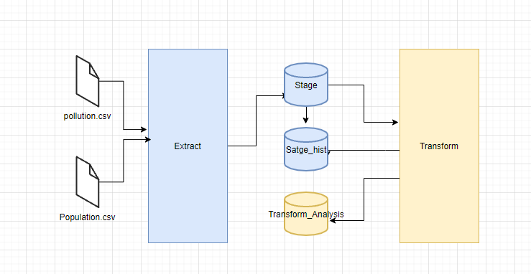
ETL Data Flow

Slide 5
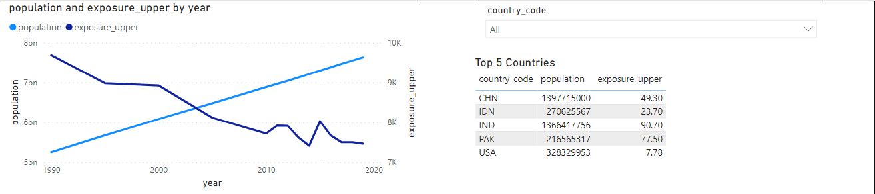
Analysis

Slide 6

Thank You

Slide 7

Questions

